Slide 1

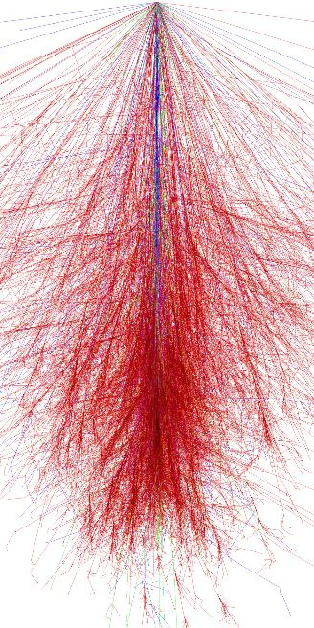

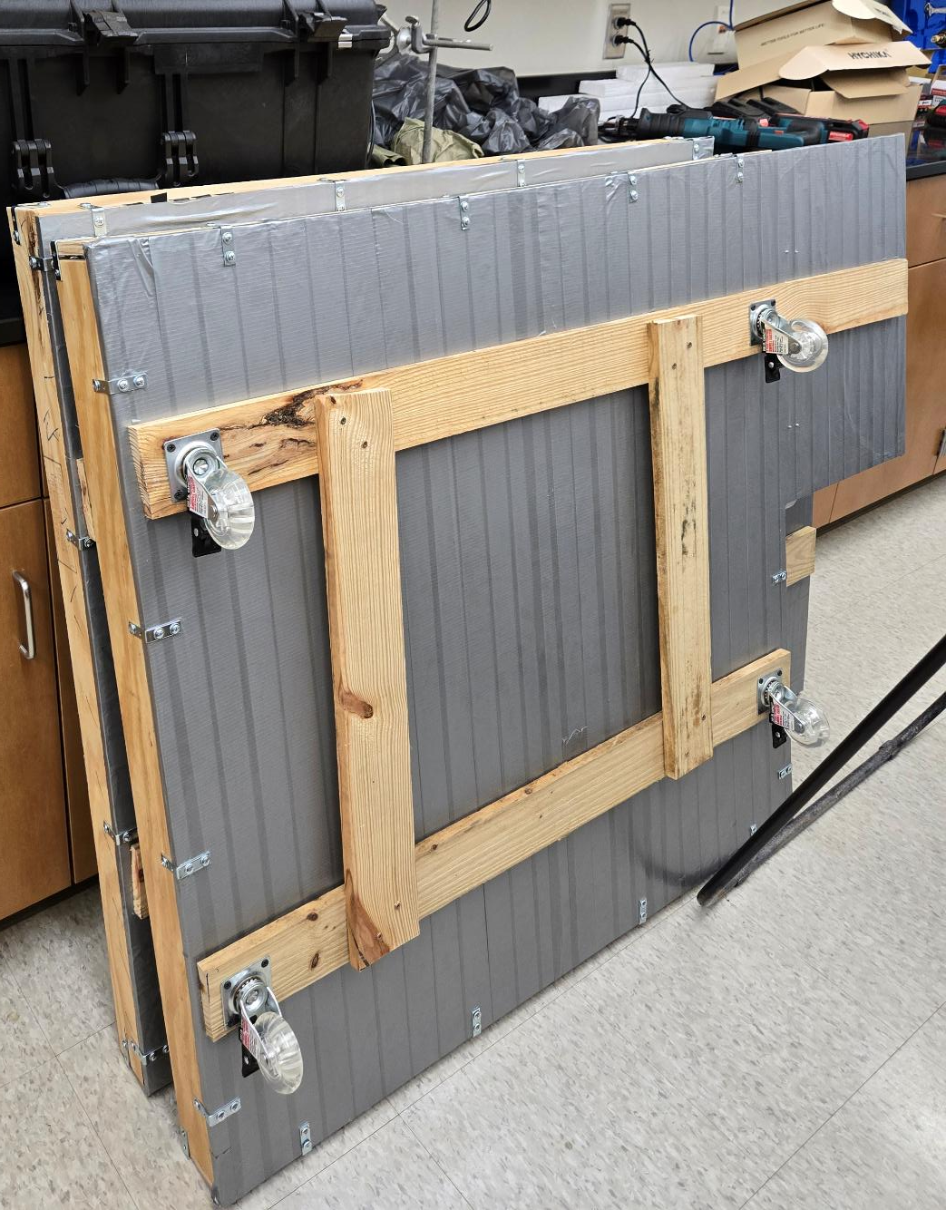
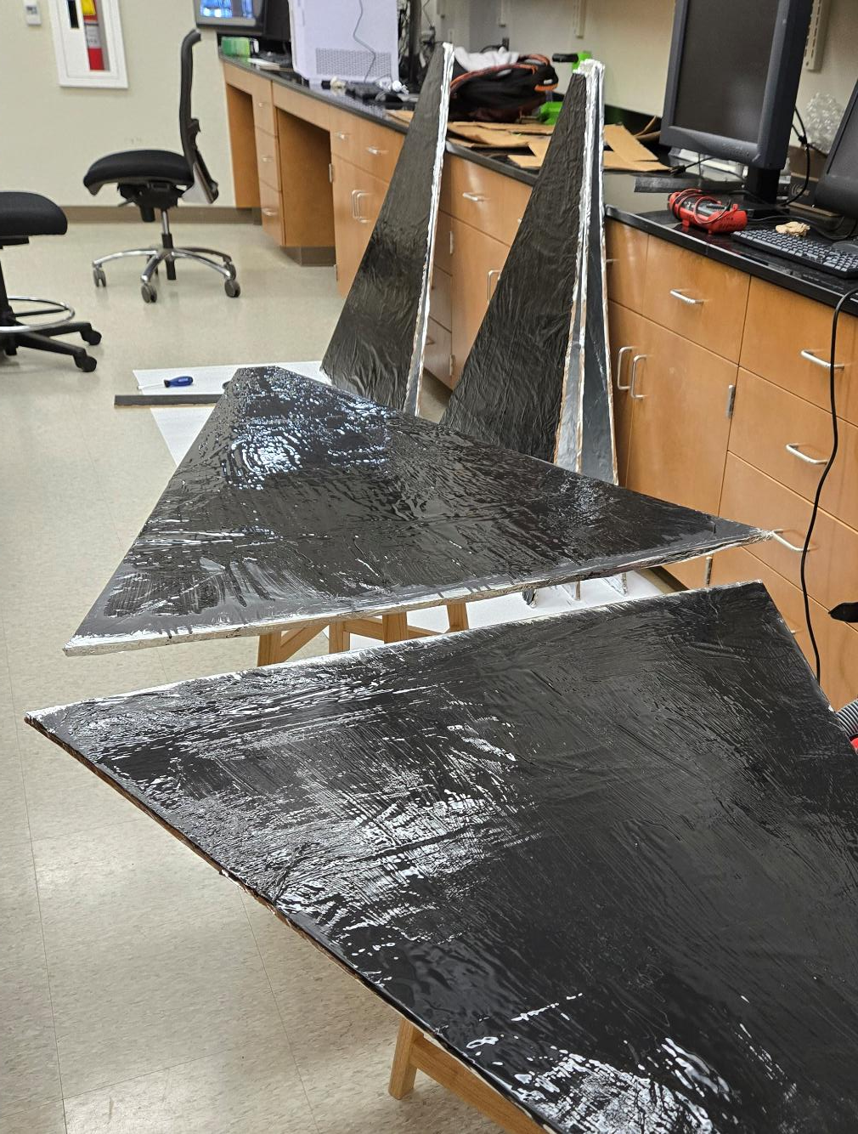
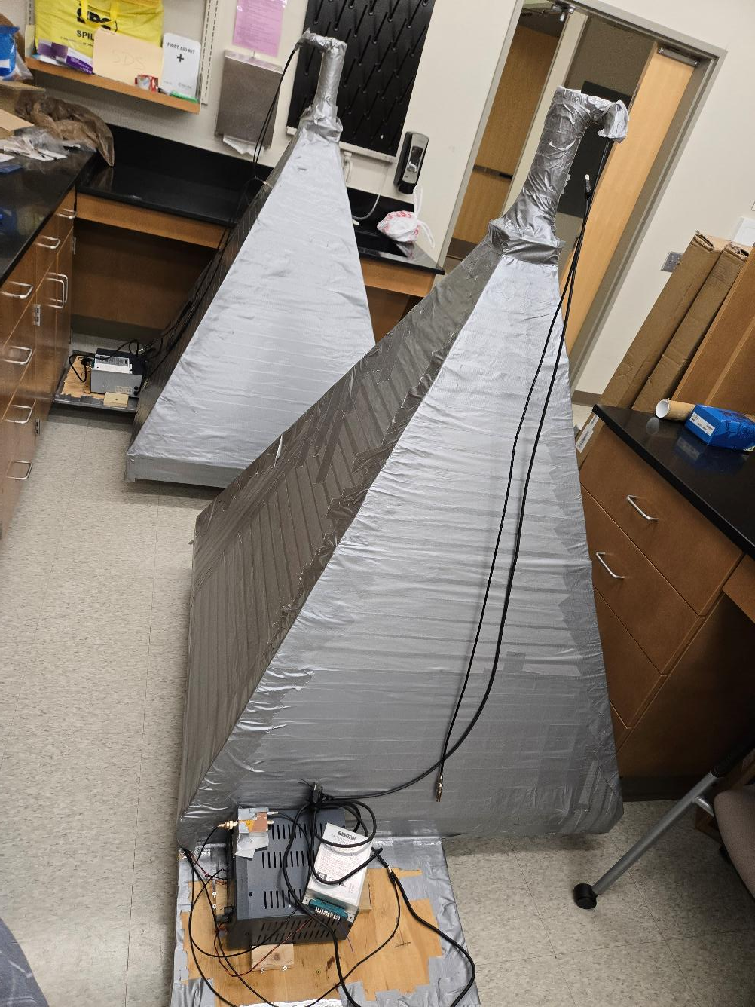
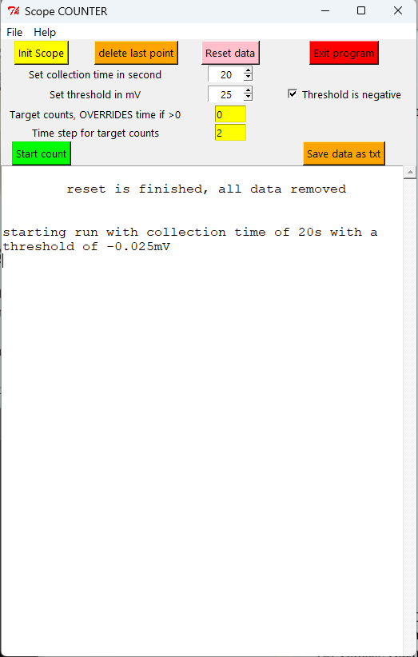
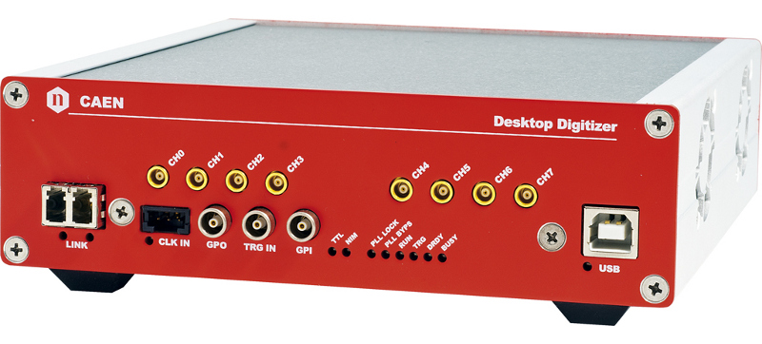
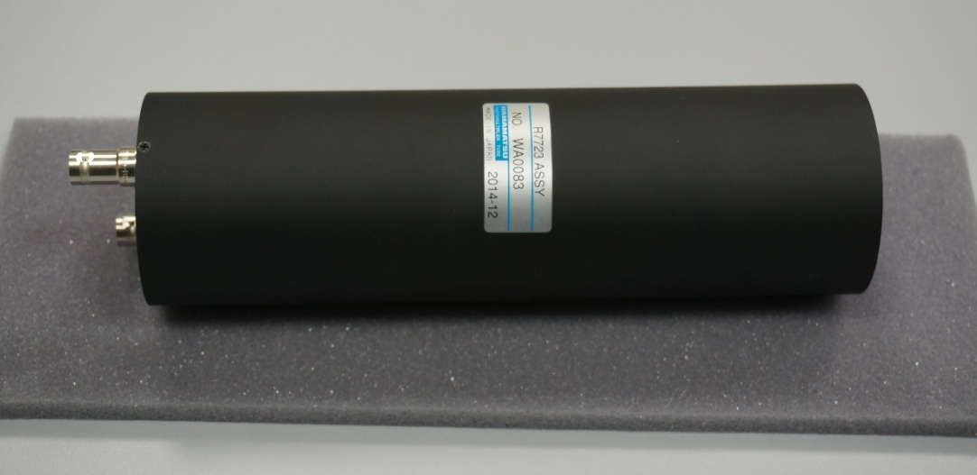
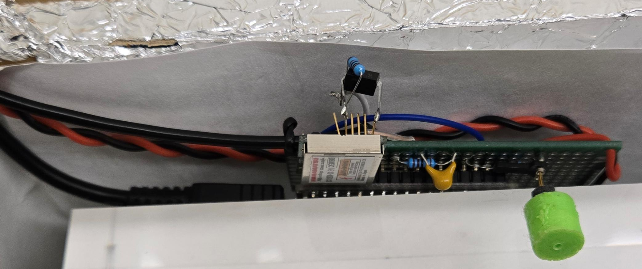
Calibration Activities and Finalizing Construction of DUCK
Dmitriy Beznosko, Xuong Minh Tran*
School of Sciences Experiential Learning Forum
Nov 21, 2025, CLSU, Morrow, GA
*presenter, xtran2@student.clayton.edu
Project Introduction
The project presented includes the development, calibration, design, construction and deployment of core modules of DUCK (Detector system of Unusual Cosmic-ray casKades) [1], a cosmic-rays detector system aimed to study the Extensive Air Shower (EAS) disk thickness as compared to CORSIKA simulations, to join the efforts in the search for the Cosmic Ray Ensembles and to further study the latest advances in the cosmic-rays field [2], like studying the multi-modal cosmic ray events. The project will involve computer simulation activities, design and construction, data acquisition system design, data collection and analysis, allowing participation of students pursuing not only physics but also other STEM fields, such as Chemistry, Engineering and Computer Science.
Project Progress
Module 1 and 2 were completed and are under calibration process (Figure 2).
Parts for modules 3 and 4 are being finished (shown in Figures 6 and 7).
The sides for the light-tight enclosure were painted to reduce reflection, which reduces the duration of the pulse by eliminating longer paths for the light to follow.
Modules need to undergo rigorous testing and calibration process after completion.
Calibration automation software development has been completed.
Software Continued
Figure 8 shows the screenshot of the software main window. The functionality allows to initialize the oscilloscope, to set the threshold, to read the count value after a preselected time period, manipulate and plot the data, and save it as a .cvs file format. A possibility to save a .ROOT file directly from the plot also exists if needed.
The calibration software uses the pyvisa interface to issue commands to the oscilloscope (VISA stands for Virtual Instrument Software Architecture).
ROOT is used for the plotting the data as its being collected and for the possibility of saving into the .root file format [3, 4]. The preference is given to the .cvs format for the data as the datafiles are small and the .cvs format is more flexible and easier to work with.
Figure 9 shows plot of log of noise rate vs. voltage threshold measured from MPPC photosensor. The characteristic steps indicate the pixel nature of this device (total of about 1200 pixels) – first step is all pixel combinations firing, second step at higher threshold is 2 pixels and higher multiplicity, third step is three pixels and above, etc.
Design Introduction
The design of the DUCK project calls for the basic 4 modules. The design for a single module is shown in Figure 1, and two completed modules are in Figure 2. Each module has a 5-cm thick, 1m x 1m plastic scintillator, a 2-inch PMT (photo multiplier tube) for the light detection, each module would be calibrated to assess the particle density.
Fast response of each module makes possible to record waveform of the signal to look for the unusual events CAEN DT5730 FADC is used (Figure 3), with 14-bit resolution and 500 MHz digitization speed for the fast signal resolution and custom DAQ software [3, 4]. Hamamatsu H11284-30 (former R7723) PMT is chosen for the large area of the photocathode (2”) and fast output pulse (Figure 4). Hamamatsu MPPC + WLS fiber for MIP calibration of each module. Figure 5 shows the biasing board for the MPPC. LED is used for PMT gain monitoring and single photon calibration
Conclusion
The status of the DUCK project:
2 modules are complete
The remaining two are in the process of assembly
Calibration are in progress
All electronic components have been acquired
Calibration automation software is complete
Figure 6: Bases for modules 3 and 4 are complete
Figure 7: Sides for modules 3 and 4 are getting a non-reflective coating
LV power supply
ADC
Calibration Automation Software
The calibration of the detector module starts with finding the biasing voltage for the two photosensors used – PMT and MPPC. The initial stage of this process involves measuring the noise rate vs the biasing voltage at each device.
The process involves counting the noise rate at multiple threshold values for each bias voltage amount. The counting is done by the oscilloscope, and the threshold settings need to be updated at each measurement. Bias voltage is updated at the power supply. Therefore, software that updates the threshold and saves the values in a convenient format (.csv) is an asset.
Future Plans
The following immediate tasks are needed for the completion of the DUCK project:
Finish the assembly of modules 3 and 4
Complete the electronic parts for those modules
Complete all calibration activities
Prepare signal cables
Start initial runs using 2 modules at the time (i.e. separation curve test)
Prepare for the modules placement and physics run
HV power supply
PMT
Function generator
WLS Fiber
MPPC
Scintillator
LED
References
[1] D. Beznosko et al., “Progress of construction and calibration of main modules for the DUCK (Detector of Unusual casKades) system”, in proceedings of
39th International Cosmic Ray Conference, PoS(ICRC2025)191, 2025/10/04 https://doi.org/10.22323/1.501.0191
[2] Tomasz Hachaj et al., “Towards detection of anomalous cosmic ray signals for observations acquired from Cosmic Ray Extremely Distributed Observatory mobile detectors”, Engineering Applications of Artificial Intelligence 161 112109, 2025/12/9 https://doi.org/10.1016/j.engappai.2025.112109
[3] Dmitriy Beznosko, Valeriy Aseykin, Alexander Dyshkant, Fernando Guadarrama, Alexander Iakovlev, Oleg Krivosheev, Tatiana Krivosheev, Alexander Ramirez, Vladimir Shiltsev, Xuong Minh Tran, and Valeriy Zhukov. "Construction progress of Detector of Unusual Cosmic-ray casKades", Proceedings of 4th Annual College of STEM Symposium, PROC(04ACSS2025)002, 03/2025 https://sos.clayton.edu/proceedings/004/PROC(04ACSS2025)002.pdf
[4] Dmitriy Beznosko, Farid Gasratov, Fernando Guadarrama, Alexander Iakovlev, “Scripting data acquisition operations and choice of data format for the data files of the DUCK ultra-high energy cosmic rays detector”, arXiv:2501.08235, 2025/1/14, https://doi.org/10.48550/arXiv.2501.08235
Figure 1: The schematic design of the basic module
Figure 2: Basic modules #1 and #2 are completed
Figure 3: CAEN DT5730 FADC
Figure 4: Hamamatsu PMT H11284-30 (former R7723)
Figure 8. The main window of the calibration software
Figure 9. The MPPC log10 of noise rate vs the threshold for 67.6V bias
Figure 5: Hamamatsu MPPC and Biasing board

